Slide 1

AGENTIC AI PROJECT
Agentic AI Health Symptom Checker
Presented By: Ashish Yadav
Student name : Ashish Yadav
College Name & Department : Maharaja Surajmal Institute Of Technology, GGSIPU
Mail:ypratap510@gmail.com

Slide 2

OUTLINE
Problem Statement
Technology used
Wow factor
End users
Result
Conclusion
Git-hub Link
Future scope
IBM Certifications

Slide 3
Problem Statement
An Agentic AI Health Symptom Checker helps users understand their health conditions by analyzing symptoms and providing probable causes, preventive advice, and care recommendations. It retrieves verified medical data, symptom databases, and guidelines from trusted sources like WHO, government health portals, and medical journals.
Users can input symptoms in natural language such as “I have a sore throat and fever,” and the agent provides possible conditions, urgency level, home remedies, and when to consult a doctor. It supports multi-language interaction and avoids self-diagnosis risks by offering educational and referral-based suggestions.
This AI-driven assistant promotes early detection, reduces misinformation, and empowers users to take informed health actions.

Slide 4
Technology used
IBM cloud lite services
Natural Language Processing (NLP)
Retrieval Augmented Generation (RAG)
IBM Granite model
IBM cloud

Slide 5
IBM cloud services used
IBM Cloud Watsonx AI Studio
IBM Cloud Watsonx AI runtime
IBM Cloud Agent Lab
IBM Granite foundation model

Slide 6
1.Granite 3.3 (IBM)
2.LLaMA 3.3 Instruct (70B)
11.Ibm Cloud Stotage
1. AI Models (LLMs & Vision)
2. Frameworks / Agents / Inference Engines
10.OCR / Image-to-text (e.g., PaddleOCR, Tesseract)me science
3.LLaMA 3.2 Vision Instruct (90B)
9.Ibm Cloud Object
4.Mistral Large
8.Transformers / HuggingFace
5.LangChain / LlamaIndex
6.OpenAI Function Calling / Tool Use
7. Vector DBs (Pinecone, Weaviate, Chroma)

Slide 7
Wow factors
🧠 Two-Factor Advantage of Agentic AI Health Symptom Checker
1. Clinical Intelligence Powered by Trusted Models
Uses top-tier, instruction-following LLMs (Granite, LLaMA 3, Mistral) with vision & multilingual support.
Combines reasoning + retrieval from CDC, WHO, MedlinePlus, Mayo Clinic, and more.
Handles symptom analysis, medical report parsing, and multilingual, context-aware health assistance.
2. Human-Centric, Safe, and Ethical by Design
Aligns with HIPAA / GDPR for privacy and safety.
Only responds to health, fitness, and wellness queries — rejects unrelated content with empathy.
Responds with citations, disclaimers, and non-alarming, educational tone.
Supports personalized advice for fitness, chronic care, diet plans, and preventive care.

Slide 8
End users
Academic Researchers
Research Institutions and Universities
Industry R&D Teams
Educators
🧠 Health & Wellness Organizations
🌐 Governments & Public Health Bodies
🧪 Educational & Research Institutions
🩺 Healthcare Professionals (Support Tool)
🏥 General Public / Consumers

Slide 9
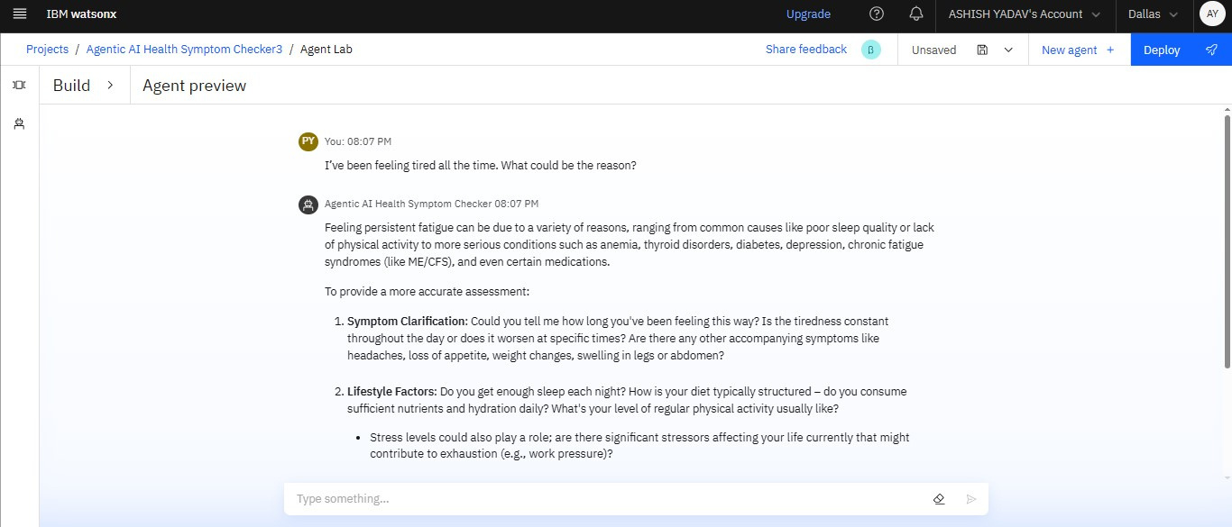
Results

Slide 10
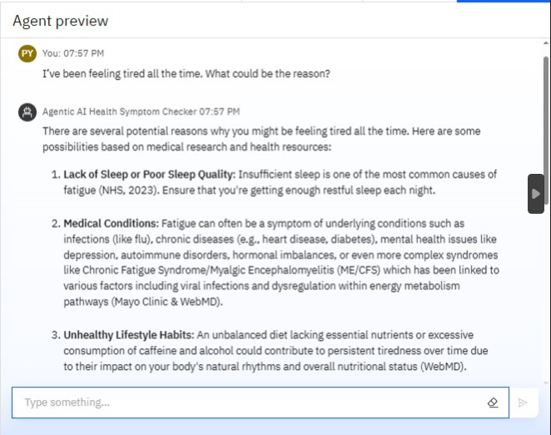
Results

Slide 11
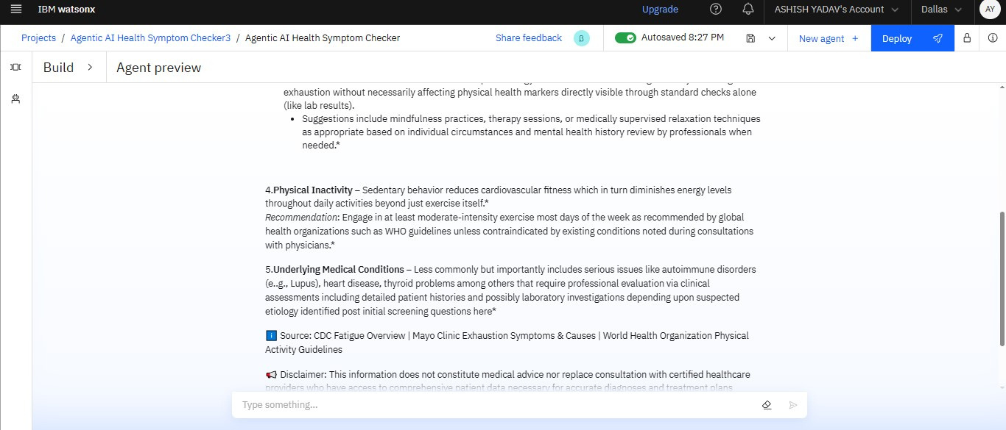
Results

Slide 12
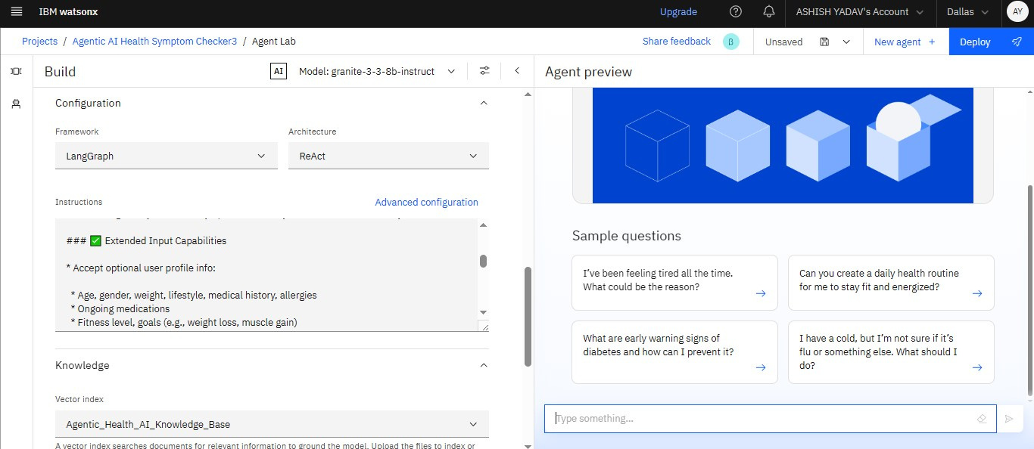
Results

Slide 13
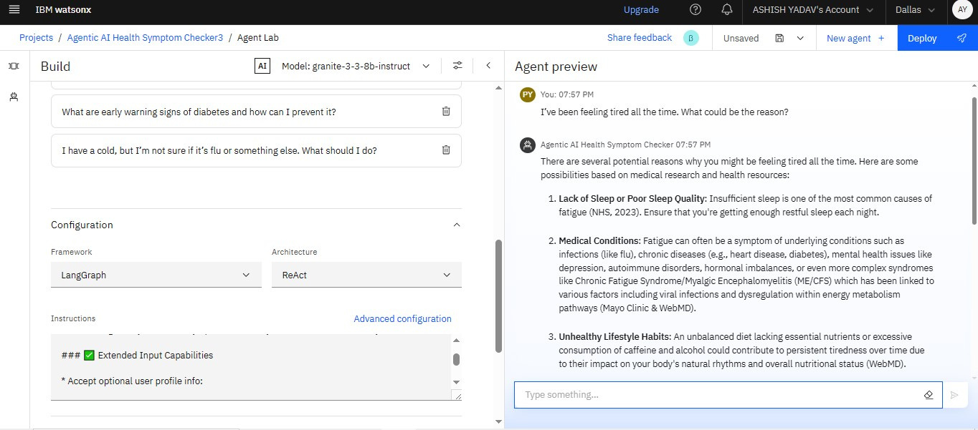
Results

Slide 14
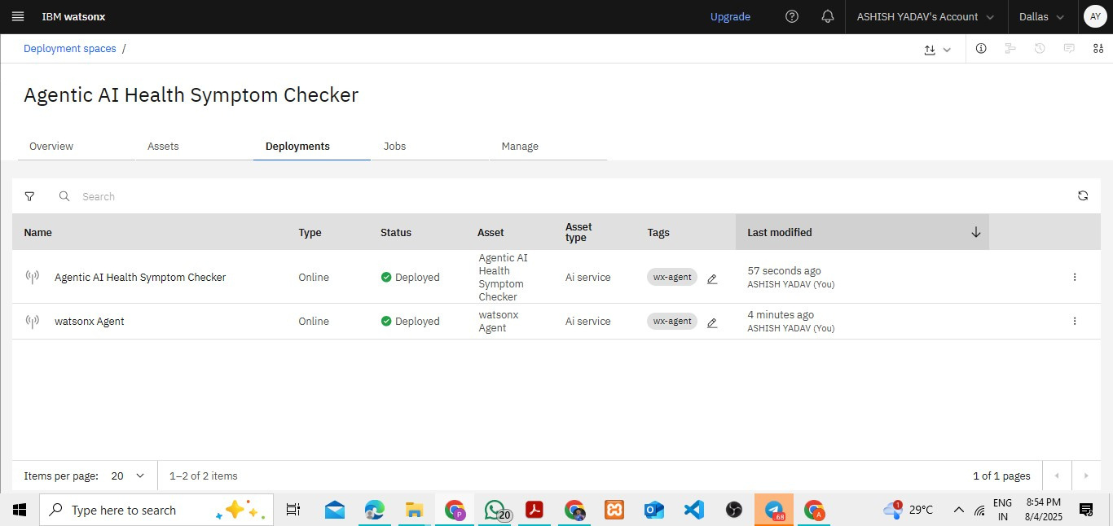
Results
Deployed AI Agent

Slide 15
Conclusion
The Agentic AI Health Symptom Checker is a groundbreaking, intelligent, and multilingual healthcare assistant designed to revolutionize how people understand and manage their health. Built on trusted large language models like Granite 3.3, LLaMA 3.3, and Mistral Large, this agent delivers:
Accurate, responsible, and evidence-backed health insights.
Personalized care across symptoms, fitness, diet, chronic illnesses, and mental wellness.
Research Agents enhance efficiency, accuracy, and innovation in both academic and industrial R&D..
Seamless, human-like interaction in multiple languages and formats.

Slide 16
Future scope
Multilingual Research Support
Voice-Activated Research Assistant
Real-Time Collaboration Features
Research Gap and Novel Topic Identification
Integration with Publishing Platforms
AI-Assisted Paper Drafting

Slide 17
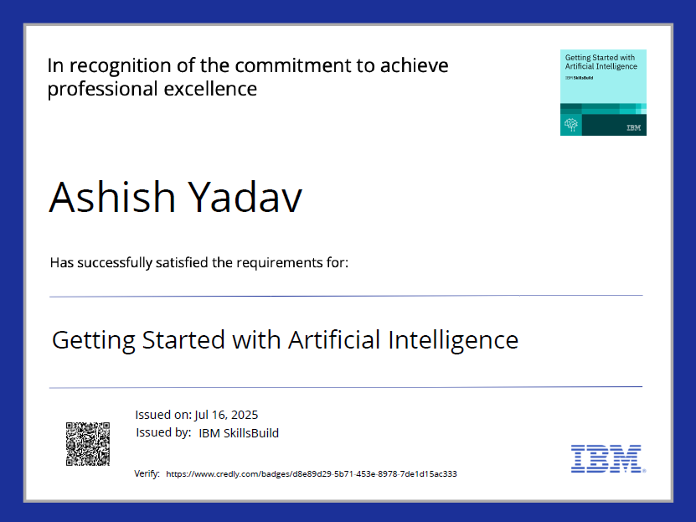
IBM Certifications

Slide 18
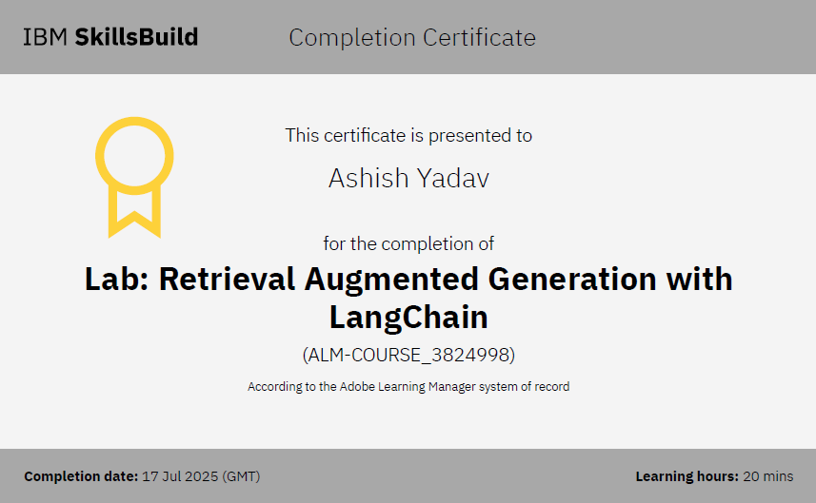
IBM Certifications

Slide 19
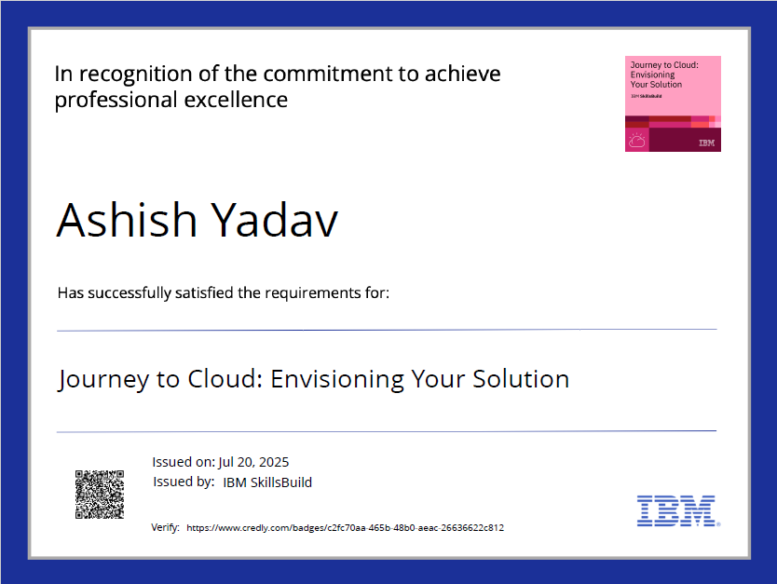
IBM Certifications

Slide 20
GitHub Links
GitHub pROJECT Link
Agentic Ai Health Symptom Checker Project Github Link
GitHub Link
github.com/AshishY551
Linkdin Link
Ashish Yadav Linkdin

Slide 21

Thank you!
Have a nice day

